Slide 1
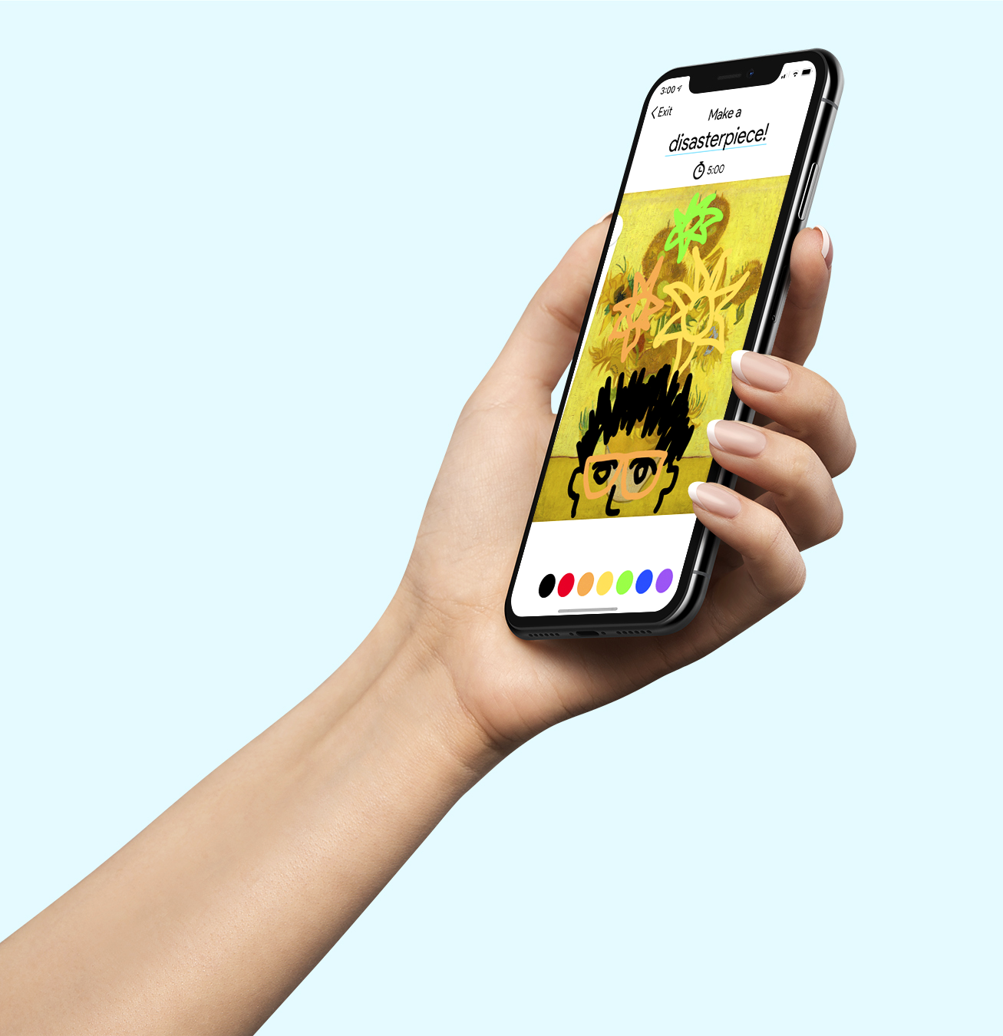
Hi, I’m
Artbot.
–
Midway Milestone
Team Articulate

Slide 2
Our rundown for today:
Problem & Solution Overview
Value Proposition
Heuristic Evaluation
Solutions
Prototype Implementation
Tools
Hard-coding/Wizard of Oz techniques
Demo

Slide 3
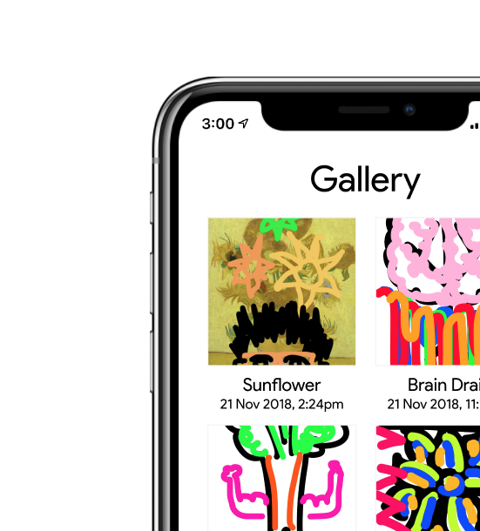
Your antagonistic, artful companion.
We set out to tackle the dreaded problem artists of all levels face during the creation process – the block.
The block happens when artists become too attached to their work and are unable to see a path forward in their work that satisfies them.
Artbot frees artists from this mode of thinking using a gamified approach coupled with long-term check-ins.

Slide 4
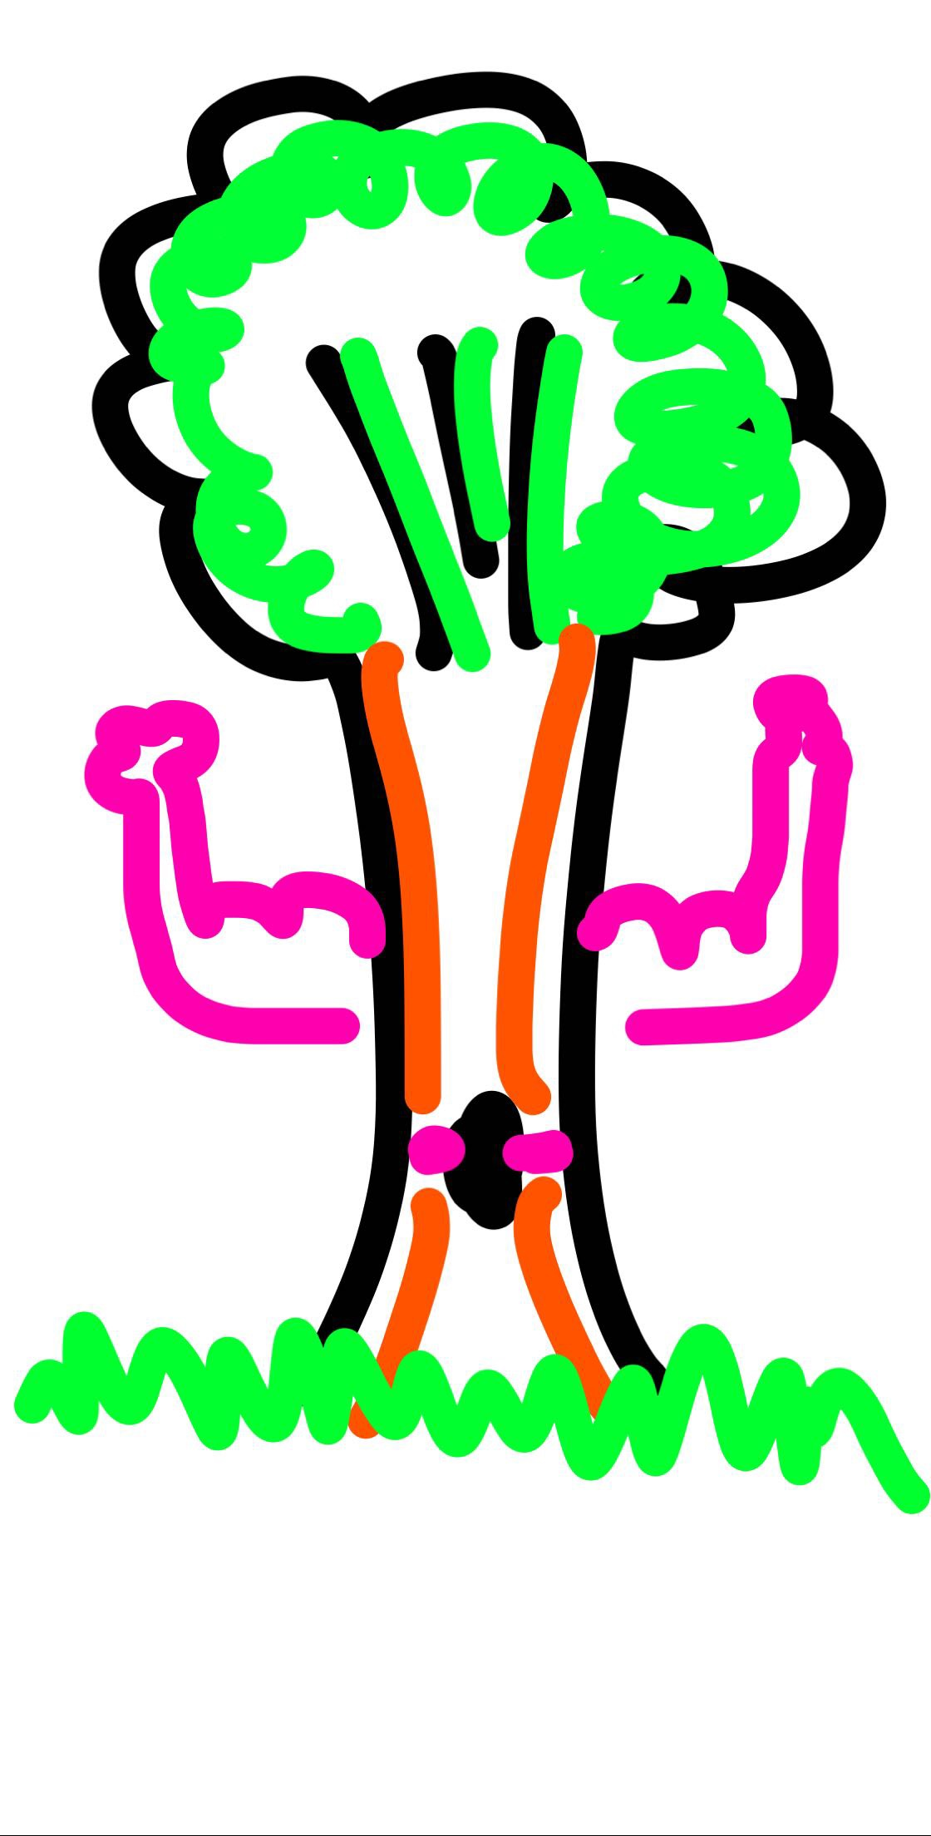
We learned a lot from our heuristic eval!
We realized we weren’t being totally consistent with our internal graphic standards.
The blue underline was being used a variety of ways. Is it a link? Used for emphasis?
What distinguished an inset screen from a new screen?
Why were some screens all blue and others white?

Slide 5
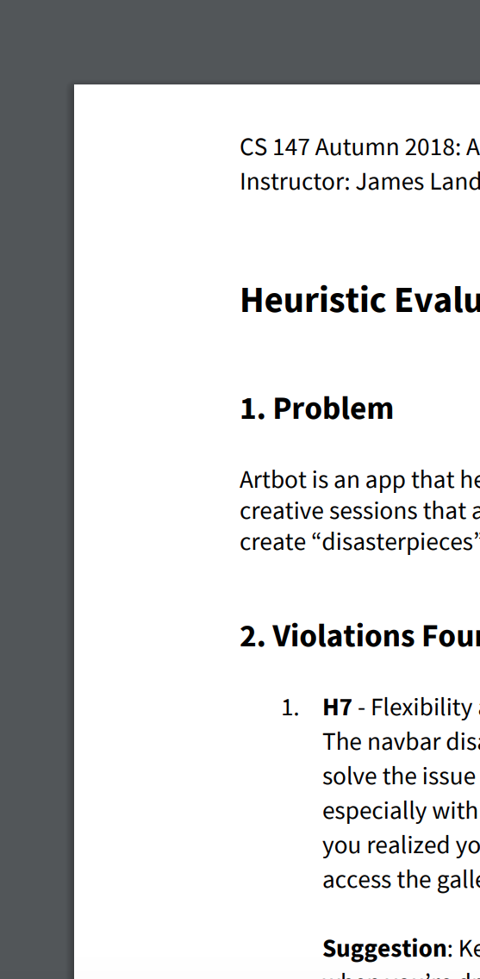
...like, a lot. 😓
We weren’t being cognizant of how users would approach some aspects of the app.
Our complex task (long-term daily check-ins) was not reinforced well enough through the app.
We chose a weird action for users to do when changing pen thickness.
Why does Creative IQ matter? What do users think when Artbot is happy vs. when it’s sad?

Slide 6
Here’s (some of) what we’re changing:
Check-in opportunities in the Gallery and Stats
Make prompts a pop-up to maximize real estate
Use a progress bar timer that moves across the screen
Clarify what Creative IQ means
Artbot’s temperament is calm vs. disruptive
Camera Roll rather than Upload
Group creation options away from check-in
Blue underline = clickable
Let users save and remove images
Pinch for pen width
Delineate the drawing canvas
Add a carousel to the gallery

Slide 7
Some of the tools we’re using are...
React Native & Xcode, for the actual implementation of the UI in our prototype;
And Firebase, for back-end real-time data collection to store keystrokes.

Slide 8
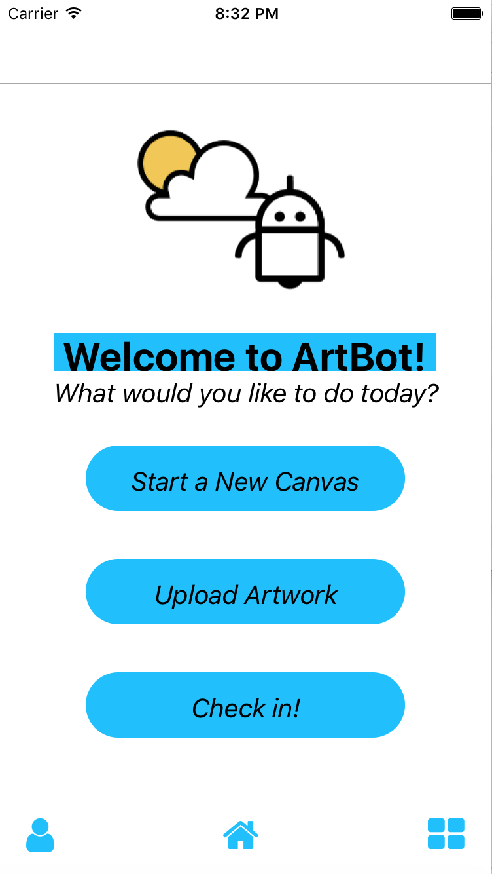
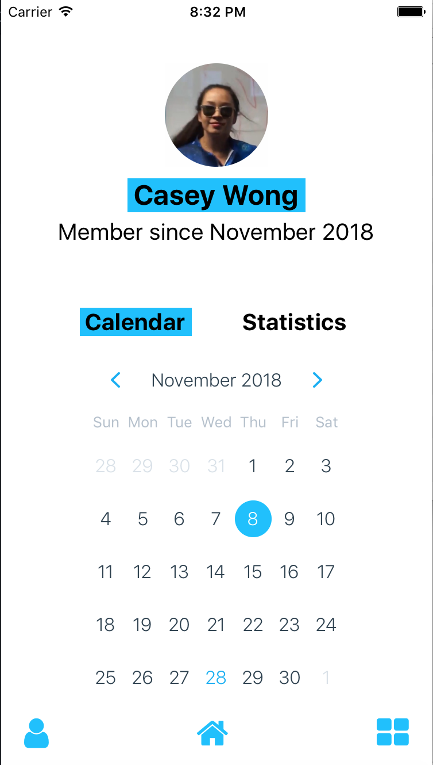
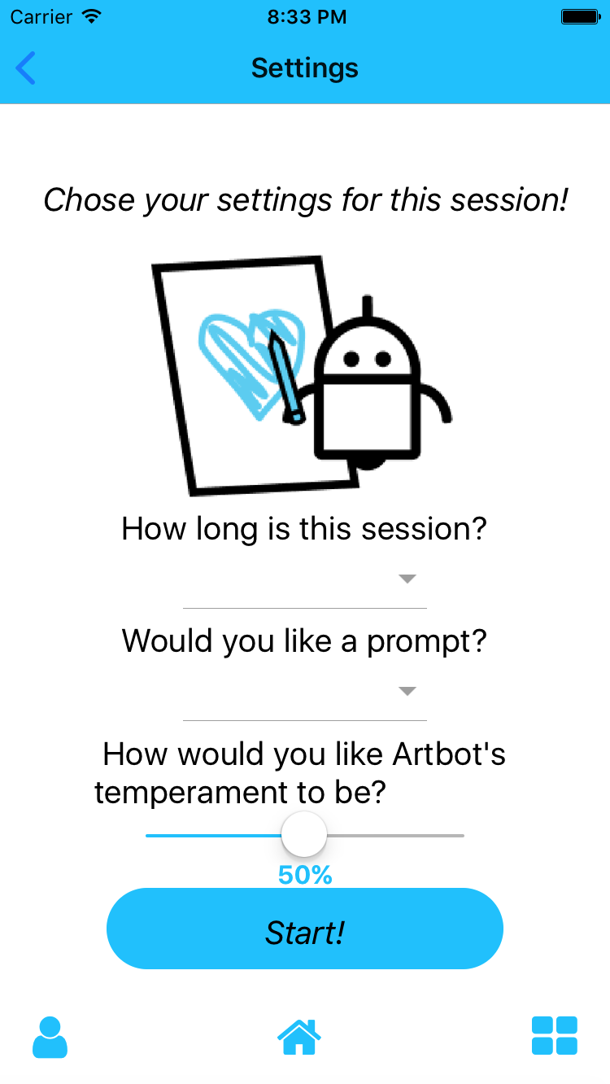
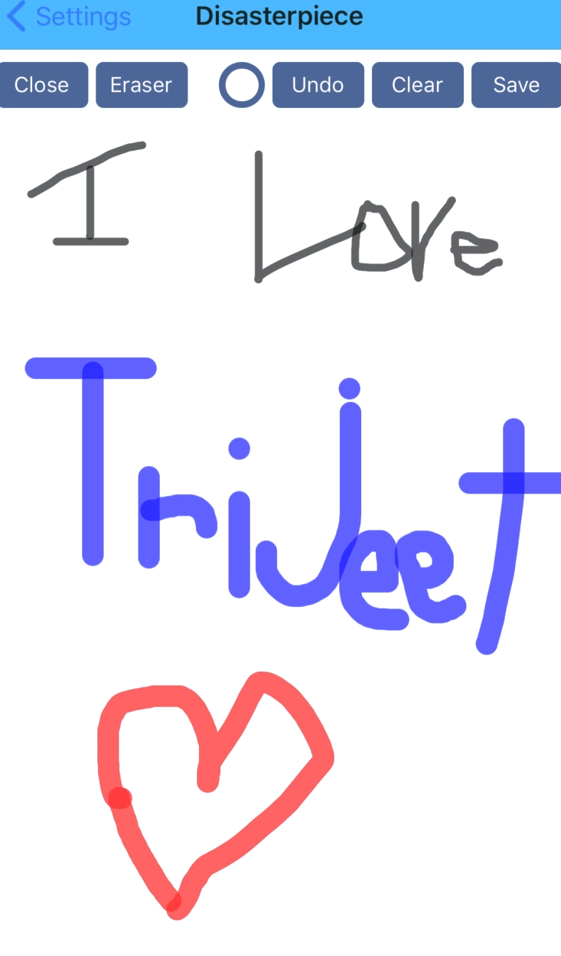
We’ve implemented a lot! 😍
Home
Calendar
Settings
Canvas

Slide 9
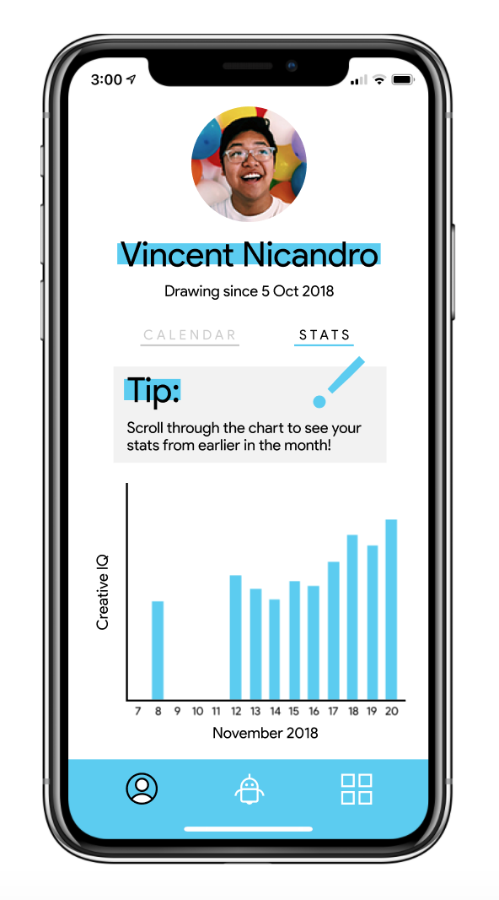
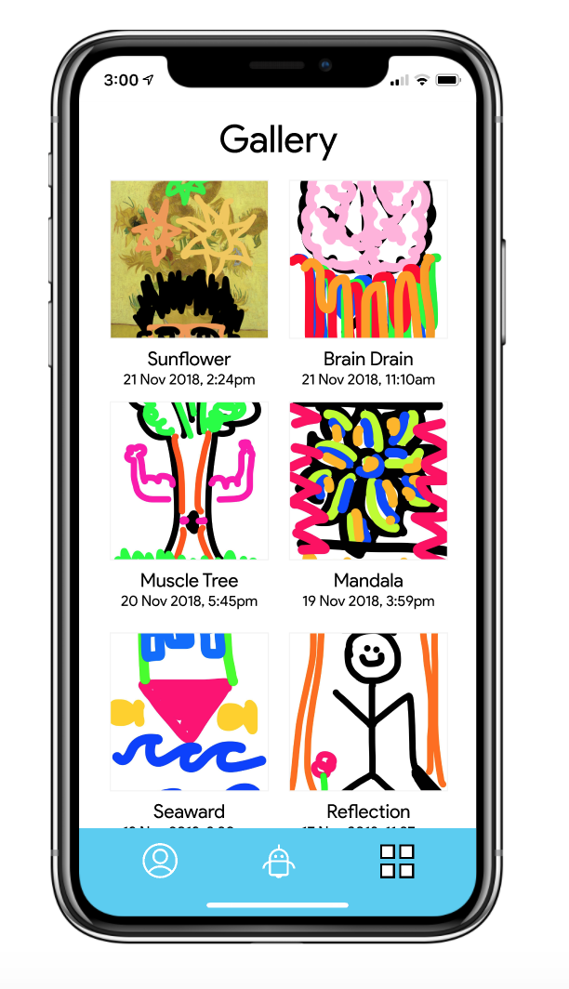
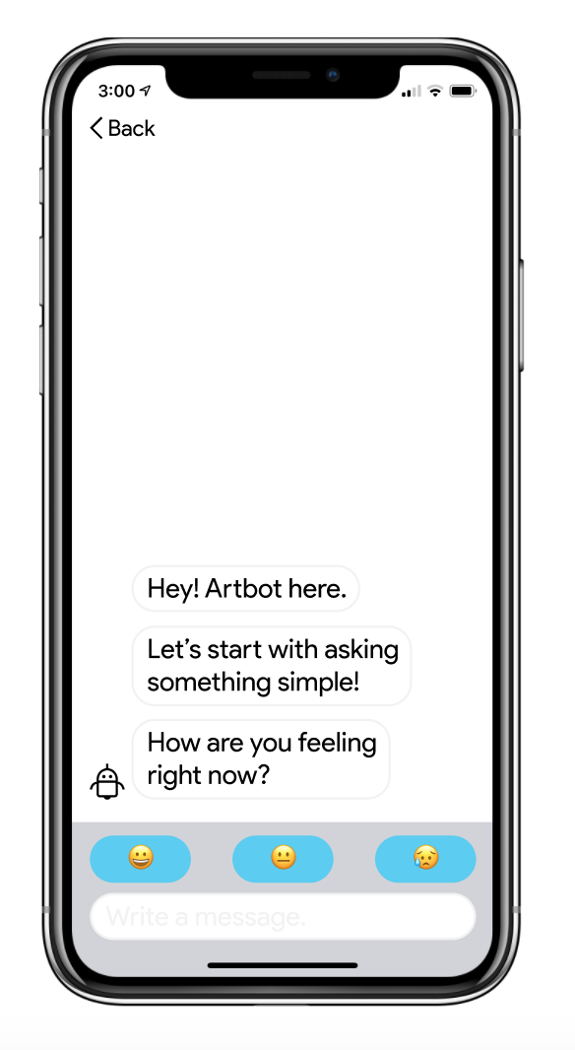
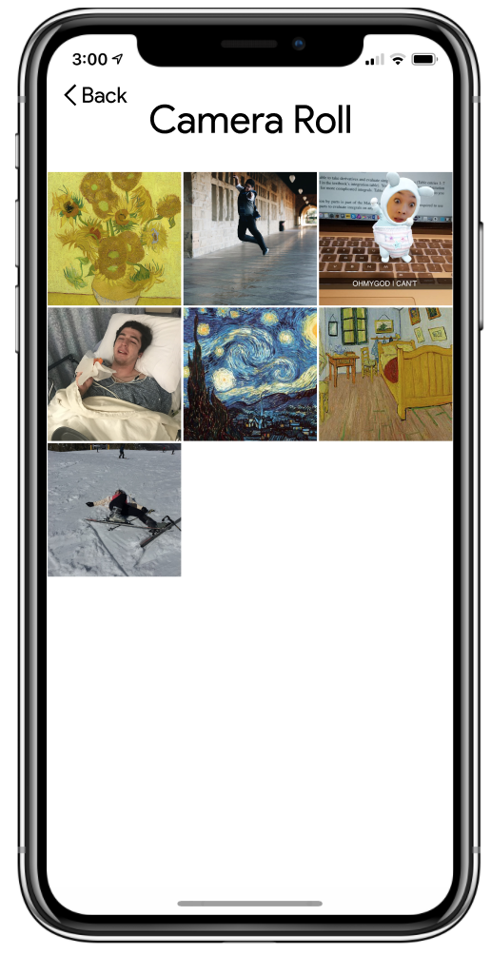
...but we’ve still got a long way to go. 😢
Statistics
Gallery
Check-In
Camera Roll

Slide 10
We’re gonna fake it ‘til we make it.
The goal of our hard-coded elements is making the app feel lived-in.
Users will be given a dummy account to navigate the app.
Images and previous statistics will be hard-coded for users to navigate with.
The chatbot will have pre-programmed responses depending on how users respond.

Slide 11
Let’s demo it!

Slide 12
To sum things up:
We reviewed the heuristic evaluation and revised our task flows accordingly;
We’re now more intentional in terms of the visual guidelines for the app, bringing attention back to the user and their disasterpieces;
And we’re on track right now to finish! 😊

Slide 13
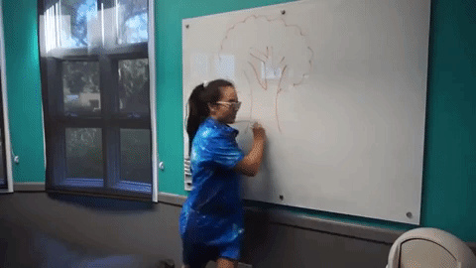
Thanks!
❤️ Articulate

